Slide 1
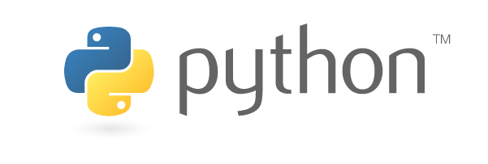
Python Programming

Slide 2
Misconceptions about Python
PYTHON IS A NEW LANGUAGE
- 23 years of age, 4-years before Java
PYTHON IS NOT COMPILED
- crucial to secure to run time environment
PYTHON IS A SCRIPTING LANGUAGE
- one of the most flexible technologies among general-use programming languages
PYTHON IS WEAKLY-TYPED
- well defined typed system
PYTHON IS SLOW
Python is a programming language, not a runtime. Cpython/Jython /IronPython /PyPy
Example: PyPy’s JIT compilation attains faster-than-C performance.

Slide 3
Misconceptions continued…
PYTHON DOES NOT SCALE
- Answer is YouTube, Dropbox, Disqus, Eventbrite, Reddit, Twilio, Instagram, Yelp, EVE Online, Second Life, and, yes, eBay and PayPal all have Python scaling stories that show scale is more than just possible: it’s a pattern.
PYTHON LACKS GOOD CONCURRENCY SUPPORT
- Check CPython execution information
PYTHON PROGRAMMERS ARE LIMITED
- trends in education suggest that this may change
PYTHON IS NOT FOR BIG JOBS
Bank of America in fact has over 5,000 Python developers, with over 10 million lines of Python in one project alone.
JP Morgan went through a comparable improvement
projects using Python normally require fewer developers than Java/C++ ☺
http://www.geo-viz.com/blog/common-misconceptions-about-enterprise-python

Slide 4
Few buzz words
general-purpose High level programming language
Interpreted at run time, no compilation is required
Interactive programming-testing-debugging
Supports both structured & Object oriented
Language Interoperability
Easy to learn-read-maintain-scale
Great for beginners, do everything you want
Created during 1985-90, by Guido Van Rossum
Available under GNU General Public License (GPL)
Lots n lots of help from Internet like stackoverflow, blogs etc.

Slide 5
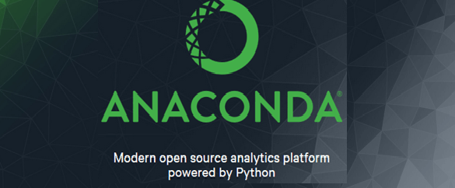
Python Installation at Nomura
Raise a ticket to install Anaconda 4.0.0 (One stop solution)
Python distribution for large-scale data processing, predictive analytics, and scientific computing
package management and deployment
Usually already includes numpy, Matplotlib, Pandas etc.
Add new package: Go to C:/Anaconda4/scripts
pip install <package-name>
Spyder- The Scientific Python Development Environment

Slide 6
Basics
Variable types
- Based on the data type of a variable, the interpreter allocates memory and decides what can be stored in the reserved memory.
- The declaration happens automatically when you assign a value to a variable.
Python has five standard data types:
1. Numbers
2. String
3. List
4. Tuple
5. Dictionary

Slide 7
Numbers
Immutable in nature
int (signed integers)
Integer are by default of long integers type
Unlimited in size
float (floating point real values)
Supports scientific notations , with E or e indicating the power of 10
(2.5e2 = 2.5 x 10² = 250)
complex (complex numbers)
- 3.14j, 9.322e-36j etc.
Wide collection of mathematical, random number and trigonometric functions

Slide 8
Strings
Index starts with 0 from beginning and -1 from end
(+) for concatenation, (*) for repetition
Can be used with single/double quotes
Triple quotes is used for multi-line comments
Extensive support of string operations

Slide 9
List & Tuple
most versatile datatype available in Python
comma-separated values (items) between square brackets
items in a list need not be of the same type
tuples cannot be changed unlike lists
Can be considered as READ-ONLY List
comma-separated values (items) between parentheses

Slide 10
Dictionary
Key-value pair
{<key>:<value>, <key>:<value>…….…}
Keys are unique while values may not be
values of a dictionary can be of any type
keys must be of an immutable data type such as strings, numbers, or tuples.
Pass by reference
Wide variety of supporting functions

Slide 11
Operators
- supports all common and advanced level of arithmetic, Comparison, Assignment, Logical , Bitwise, Membership and Identity operators
Example: in, not in, is, is not etc.
Decision making
- anticipation of conditions occurring while execution of the program and specifying actions taken according to the conditions
Example: if…else
Loops
- execute a statement or group of statements multiple times
Example: while, for and nested for

Slide 12
Functions
block of organized, reusable code that is used to perform a single, related action
Modularity & reusability
Function overloading
- Required arguments: function call should match exactly with the function definition
- Keyword arguments: identifies the arguments by the parameter name
- Default arguments: assumes a default value if a value is not provided in the function call for that argument
- Variable-length arguments: process a function for more arguments than you specified while defining the function
function can return multiple values

Slide 13
Exceptions
event, which occurs during the execution of a program that disrupts the normal flow of the program's instructions
Handle using try, except and else
A single try statement can have multiple except statements
Else block executes if no exception occurs
else-block is a good place for code that does not need the try: block's protection.
Finally block- must execute, whether the try-block raised an exception or not.
Pass an argument to an exception, raise an exception, user defined exception

Slide 14
File and Database IO
basic functions and methods necessary to manipulate files by default
Open file before read/write
Functions to create, move, rename directories
supports a wide range of database servers
- MS SQL server, Oracle, Sybase etc.
- Importing the API module. (pip install pymssql)
- Acquiring a connection with the database.
- Issuing SQL statements and stored procedures.
- Closing the connection

Slide 15
Object Oriented
Encapsulation
Inheritance
Polymorphism
Can be covered on demand ☺

Slide 16
Data visualization- Matplotlib
Matplotlib is a plotting library for the Python programming language and its numerical mathematics extension Numpy.
capable of creating most kinds of charts, like line graphs, scatter plots, bar charts, pie charts, stack plots, 3D graphs, and geographic map graphs.
In case you get error, module not found
- pip install Matplotlib

Slide 17
Scientific computations- numpy
Core package for Scientific computations
High performance computing
an extension to the python programming language, adding support for large, multi-dimensional arrays and matrices
- matrix multiplication, dot product, reshaping etc.
Along with a large library of high level mathematical functions to operate on these arrays.
In case you get error, module not found
- pip install numpy

Slide 18
Data Analysis & Manipulation- Pandas
library written for the python programming language for data manipulation and analysis.
High performance, highly efficient, and high level data analysis library.
Offers data structures and operations for manipulating numerical tables and time series.
Uses numpy for its underlying calculation
compatible with text files, csv, hdf files, xml, html, and more with its incredibly powerful IO.
- http://pandas.pydata.org/pandas-docs/stable/io.html (IO tools/APIs)
Data source: https://www.quandl.com/

Slide 19


